Slide 1
Data Collaborators
BY
Sai Kishore Bandaru, Sirish Chandra Madanapally,
Manohar Reddy Dyapa, Dayanand Saraswathi

Slide 2
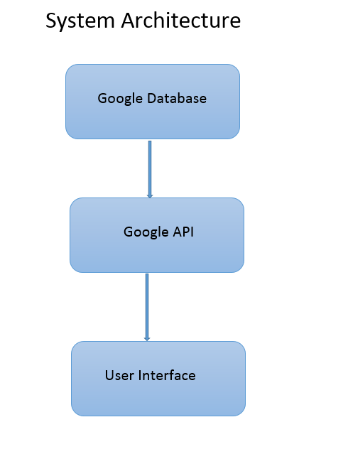

Slide 3
This web application uses google Youtube V3 APIs to retrieve the video content from web.
Users will have option to search for youtube videos using the title and location.
When the user enters search keyword and location, the application retrieves videos based on the keyword and the location.

Slide 4
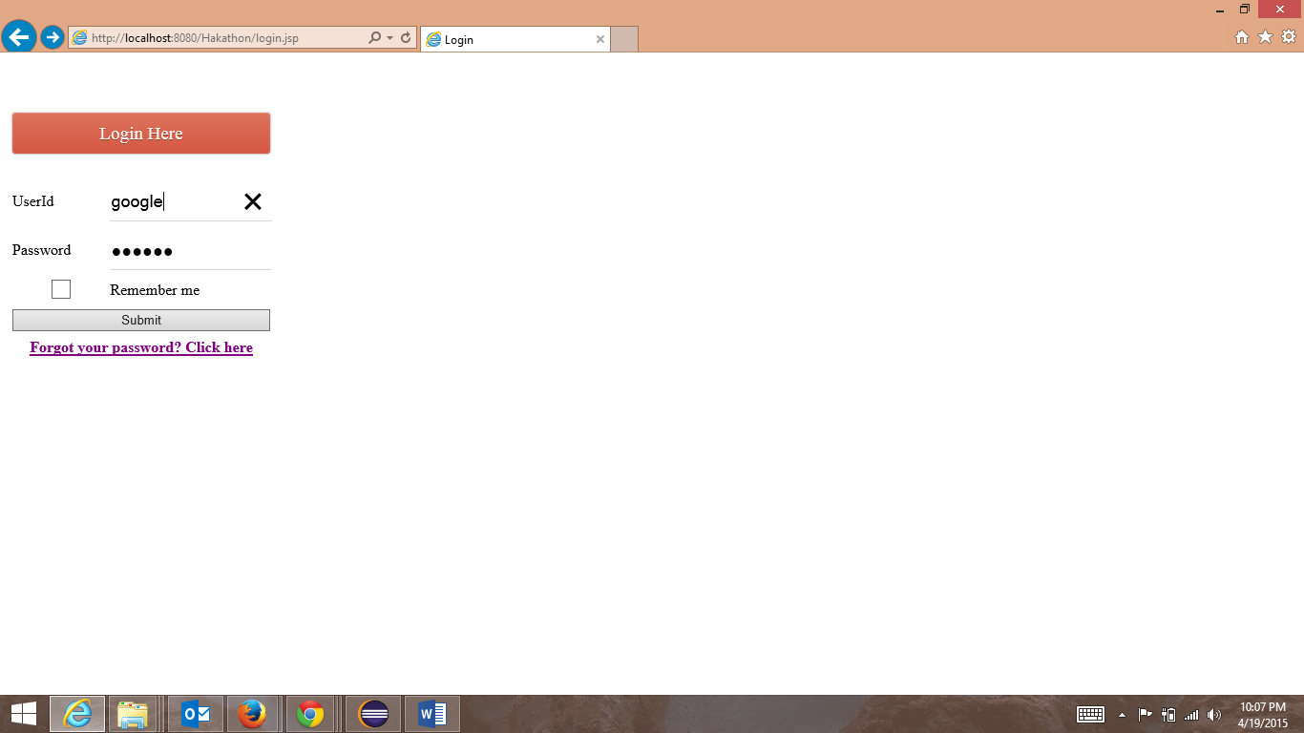
Login

Slide 5
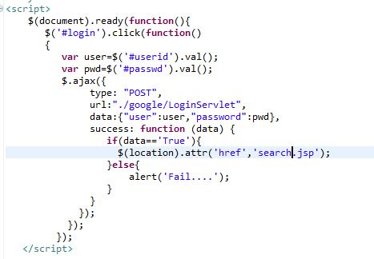
Login Functionality using Ajax calling

Slide 6
To implement ajax calling for login validation we use java script function to send the data from the jsp to the servlet.
We use the post method to send the data over the server to the servlet and get the data.
The function in the servlet validates the credentials provided and returns a Boolean value, which is used to navigate to the search page.

Slide 7
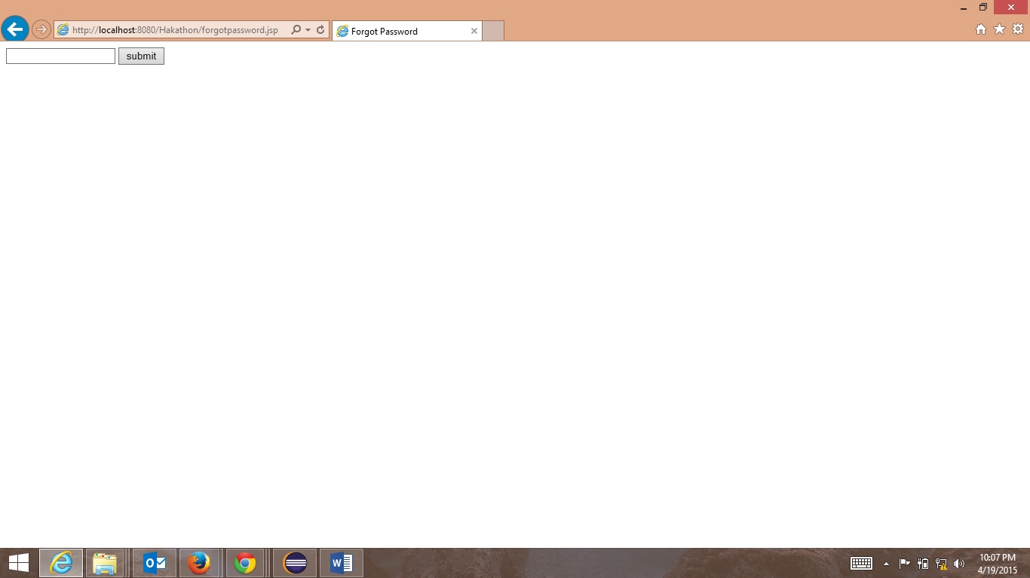
Forgot password

Slide 8
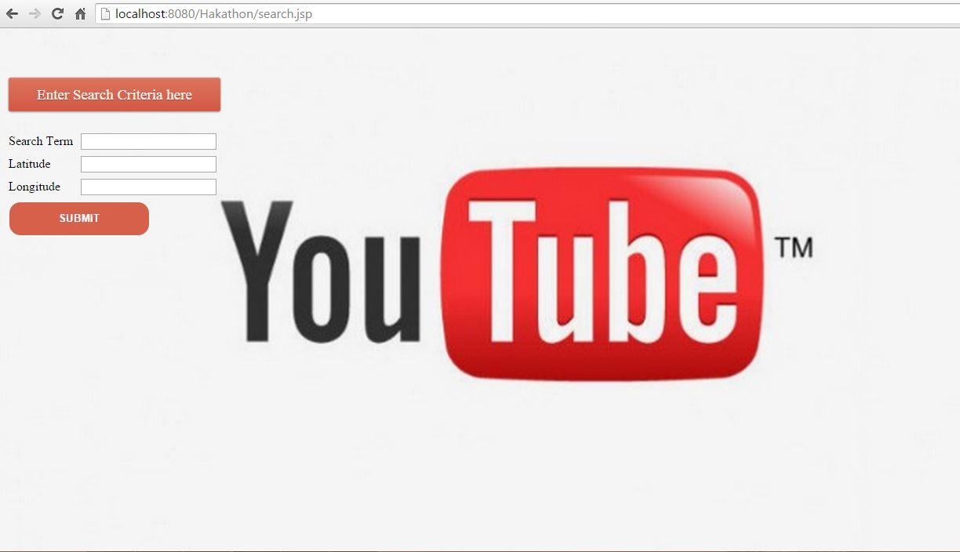
Video Search

Slide 9
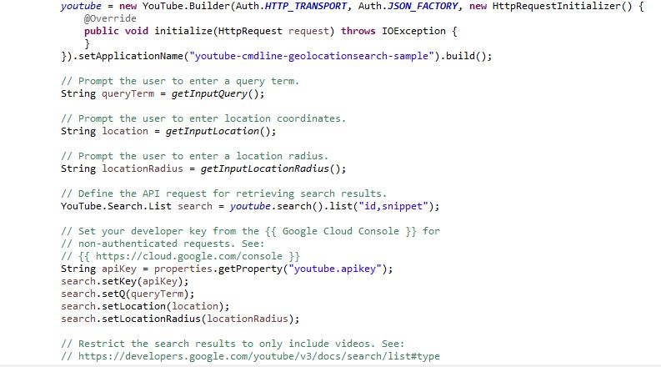
Youtube Video API

Slide 10
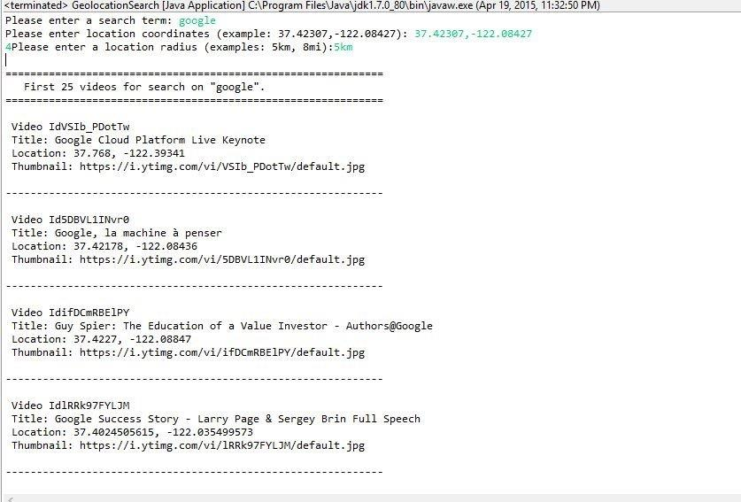
Search o utput

Slide 11
The search page consist of 3 fields ,where the user can provide the keyword for the video he/she wants to search and the location coordinates.
Then the requested parameters are sent to the servlet which then calls the google geo search api which takes the input and results a list of top 25 videos related to the search criteria.
Then the results are then sent to the SearchResult page, where the video thumbnails are presented in a grid.

Slide 12
Thank you

